Slide 1

Gokaraju Rangaraju Institute of Engineering and Technology
(Autonomous)
Department of Artificial Intelligence and Machine Learning Engineering
MINI PROJECT
Transformative NLP in Healthcare through Clinical Text Analysis with spaCy
Presented by: (Batch AA2)
1. Chilupuri Harshitha – 21241A6619
2. Papaiahgari Gayatri – 21241A6651
3. Bontha Manjula – 22245A6606
4. Jaya Mathur – 21241A6630
Under the Guidance of
Mr. Y. Bharadwaj
(Assistant Professor)

Slide 2
CONTENTS
Abstract
Problem Statement
Objectives of the Project
Existing Approaches (Literature Survey)
Architecture Diagram
Software & Hardware Requirements
References

Slide 3
Abstract
Clinical text analysis, powered by Natural Language Processing (NLP), extracts insights from unstructured clinical data, enhancing patient care and decision-making. The objective is to illuminate NLP's role in extracting crucial information from clinical documents, improving diagnosis, treatment, and outcomes. NLP aids real-time decision-making, evolving to revolutionize healthcare by analyzing unstructured clinical data. It effectively uncovers insights, enhancing diagnosis, treatment, and patient outcomes. In conclusion, NLP in clinical text analysis promises to revolutionize healthcare by improving patient care, decision-making, and outcomes

Slide 4
Problem Statement
In the realm of clinical text analysis, the challenge lies in extracting actionable insights from vast volumes of medical text data. This unstructured data presents complexities, including the nuanced language used by medical professionals and the scarcity of labeled data for training. Current methodologies struggle to cope with these complexities, limiting their effectiveness in real-world medical scenarios. Our project aims to address these challenges by implementing advanced methods to unlock the full potential of unstructured clinical data for improved healthcare outcomes.

Slide 5
Objectives of the Project
Advanced NLP analysis for real-time interpretation of complex medical narratives.
2. User-friendly interfaces for patients to understand clinical records easily.
3. Promotion of patient engagement and accuracy in diagnosis and treatment planning.
4. Creation of a collaborative healthcare environment focusing on efficiency and empowerment.

Slide 6
Existing Approaches (Literature Survey)
Reference Number | Title | Objective | Methodology | Accuracy | Pros | Research Gap
[1] | “Extracting medication information from clinical text” | A patient's clinical status or achievements during the course of a hospitalization or over the course of outpatient care is noted down | Horizontal metrics to measure performance on 'entries’ Vertical metrics to assess performance on individual 'fields’ Precision, recall, and F-measure were computed at both phrase and token levels for each metric. | As our current processing capabilities are just below 86% this leaves a significant gap of 5–10% to reach an acceptable level of accuracy | Easy to retrieve the Information and Is processed quickly | It is very limited in the field of extracting vital and relevant information with an accuracy of 85.5%
[2] | “Mayo clinical Text Analysis and Knowledge Extraction System (cTAKES)” | It’s primary objectives include: Extracting relevant medical information. Standardizing terminology for improved communication Supporting various clinical processes. | The project employed A Tokenizer Named Entity Recognition (NER) Shallow Parser as core methodologies for processing textual data. | The first case constitutes roughly 73% of all the false negatives in the PTB corpus and nearly 30% in the Mayo corpus, but it is not present in GENIA because it consists of biomedical articles | cTAKES builds on existing open-source technologies—the Unstructured Information Management Architecture framework and OpenNLP natural language processing toolkit. | As a library, NLM provides access to scientific literature. Inclusion in an NLM database does not imply endorsement of, or agreement with, the contents by NLM or the National Institutes of Health

Slide 7
Reference Number | Title | Objective | Methodology | Accuracy | Pros | Research Gap
[3] | “Modern Clinical Text Mining: A Guide and Review” | The objective is to serve as a guide for those encountering clinical text mining for the first time, addressing the transition from rule-based approaches to machine learning and deep learning. | identifying and locating mentions of a unique identity to an entity name recognized in text; in the biomedical domain, names are typically mapped to concepts from structured terminologies or ontologies, such as drug, symptom, or disease names, in text | The passage is highly accurate, around 85-89%. It effectively discusses the rise in EHR adoption, the limitations of predictive models based on structured data, and the importance of clinical text mining. | The review offers valuable insights into the advancements in clinical text mining, making it accessible to physician researchers, operational analytics teams, and machine learning scientists from other domains. | The paper effectively identifies key barriers between technical advancements in clinical text mining and their implementation in health systems and industry. However, it may not provide an exhaustive survey of all developments in the field, potentially leaving out some recent advancements or challenges
[4] | “Clinical text analysis using machine learning methods” | The main aim of this study was to provide systematic evidence on the properties of text data used to train machine learning approaches to clinical NLP. We also investigated the types of NLP tasks that have been supported by machine learning and how they can be applied in clinical practice. | Reviewed different modelling approaches , that includes Unified modeling language (UML), Natural language processing Text analysis | The study accurately notes that data utilization in machine learning studies varied widely, ranging from 0.002% to 11.88% of available data. | It offers insights into the utilization of relatively small datasets, the exploration of active learning and distant supervision, and the applications of machine learning in various clinical tasks. | The paper highlights the need for alternatives to traditional data annotation methods, such as data augmentation and transfer learning, to address the annotation bottleneck. It also suggests a gap in understanding the generalizability of machine learning models across healthcare settings

Slide 8
Reference Number | Title | Objective | Methodology | Accuracy | Pros | Research Gap
[5] | “Different Data Mining Approaches Based on Medical Text Data” | This project aims to assess various data mining approaches for extracting valuable information from medical text data, focusing on four key steps. It seeks to aid researchers in selecting suitable methodologies for mining medical text data and address challenges inherent in the process. | Employed a methodology integrating Natural Language Processing with Data Analysis techniques, complemented by machine learning algorithms such as Artificial Neural Networks, Naive Bayes, and Decision Trees, to conduct comprehensive analysis and extract insights from the dataset. | The project accurately identifies the lack of publicly available annotation databases, heterogeneity in medical information, and privacy concerns as major obstacles in medical text data mining | The project offers valuable insights into the difficulties encountered in mining medical text data, proposing future directions for standardization efforts. It provides a thorough overview of obstacles from various perspectives, aiding researchers in understanding nuanced challenges in this domain. | The project identifies a significant gap in the availability of standardized annotation databases for medical text data mining, emphasizing the need for collaborative efforts to address this limitation.
[6] | “Text Mining cancer – related information: Review of Current Status and Future Directions” | This paper aims to review the current status of text mining (TM) in cancer research, focusing on domains, knowledge resources, and the conversion of text data into clinical information, to suggest future TM directions. | Methods and techniques used to solve them in the cancer domain are differentiated between four major NLP tasks: Named entity recognition (NER), Information extraction (IE), Text classification and Information retrieval (IR) | The paper accurately reports NER achieves an F-measure of 80%-90% and IE achieves high 90s. It identifies gaps in cancer ontologies and accessing training data due to privacy concerns as barriers in TM research. | It provides valuable insights into TM's potential in cancer research, critiques existing methods, and proposes machine learning adoption. It underscores the importance of cancer ontologies and addresses challenges like accessing training data due to privacy concerns, offering directions for future research. | The paper identifies gaps in comprehensive cancer ontologies, accessing training datasets, and privacy concerns regarding clinical data as significant challenges in TM research, suggesting ways to address these issues for progress in the field.

Slide 9
Reference Number | Title | Objective | Methodology | Accuracy | Pros | Research Gap
[7] | “Using natural language processing methods to classify use status of dietary supplements in clinical notes” | The objective is to classify the use status of dietary supplements in clinical notes using natural language processing (NLP) methods, aiming for accuracy and scalability in supplement safety research. | Both rule-based and machine learning-based classifiers were developed on the same training set and evaluated using the hold-out test set. The performances of the two classifiers were also compared. | The rule-based classifier achieves F-measures of 0.90 (C), 0.85 (D), 0.90 (S), and 0.86 (U) status. The machine learning-based classifier (Maximum Entropy) achieves F-measures of 0.90 (C), 0.92 (D), 0.91 (S), and 0.88 (U) status, indicating its superiority in performance. | This study provides an efficient and scalable method for classifying dietary supplement use status in clinical notes, enhancing active pharmacovigilance efforts. | The project fills a gap in supplement safety research by offering a reliable method for extracting dietary supplement information from electronic health records (EHRs). It underscores the importance of leveraging NLP techniques to enhance pharmacovigilance efforts regarding dietary supplement usage.
[8] | “Recent Advances in Clinical Natural Language Processing in Support of Semantic Analysis” | Develop a method utilizing a Supervised Machine Learning framework, such as Support Vector Machine (SVM), for identifying progress notes related to diabetes. Utilize a Bag-of-Words (BoW) representation to enhance the accuracy of diabetes progress note identification. | A method for identifying progress notes pertaining to diabetes was developed using A Supervised Machine learning framework like Support vector Machine(SVM) A Bag-of-words (BoW) representation | Consistent and reliable accuracy of the Bag-of-Words (BoW) representation with an accuracy rate surpassing 85% in capturing essential features and patterns indicative of diabetes progress notes, contributing to the overall precision of the classification system. | Improved accuracy in identifying progress notes specific to diabetes, facilitating targeted analysis and treatment planning. Efficient utilization of machine learning techniques to automate the process of progress note classification, saving time and resources. | Scope for investigating the impact of domain-specific knowledge incorporation or ensemble learning methods on the accuracy and robustness of progress note identification for diabetes and other medical conditions.

Slide 10
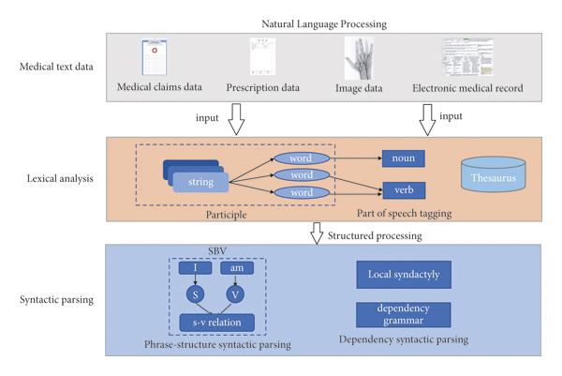
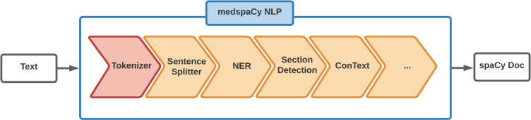
Architecture Diagram
Natural Language Processing

Slide 11
Description of Architecture Diagram
NLP (Natural Language Processing):
The input to the NLP step consists of medical text records, which may include clinical notes, discharge summaries, radiology reports, and other healthcare documents.
- Lexical Analysis: In the first stage of NLP, the text undergoes lexical analysis, which involves tokenization, stemming, and normalization.
- Syntactic Parsing: The next stage involves syntactic parsing, where the text is analyzed to identify the grammatical structure and relationships between words .This includes parsing sentences into syntactic trees, identifying parts of speech, and detecting syntactic dependencies between words.
2. MedSpaCy NLP:
Methodologies:
- Named Entity Recognition (NER): MedSpaCy NLP specializes in named entity recognition for biomedical and clinical text. It identifies and extracts entities such as medical conditions, procedures, medications, anatomical terms, and laboratory tests from the input text.
- Entity Linking: Additionally, MedSpaCy NLP may perform entity linking, associating recognized entities with standardized concepts from biomedical terminologies or ontologies. This enables semantic understanding and interoperability with external knowledge resources.
3. Spacy Doc:
Methodologies:
- Document-Level Analysis: Spacy Doc focuses on document-level analysis, where the entire medical text is processed as a single unit. This may involve summarization, sentiment analysis, topic modeling, or other higher-level analyses aimed at extracting actionable insights from the clinical text.
- Integration with Spacy: Spacy Doc leverages the capabilities of the Spacy library, a popular natural language processing toolkit, for efficient and scalable text processing. This includes advanced linguistic features, entity recognition, and customizable pipeline components.

Slide 12
Dataset Details
Dataset: The Dataset for ‘Clinical Text Analysis’ typically consists of Medical Dataset for Abbreviation Disambiguation for Natural Language Understanding (MeDAL). MeDAL is a large medical text dataset curated for abbreviation disambiguation, designed for natural language understanding pre-training in the medical domain. It was published at the ClinicalNLP workshop at EMNLP.
- It is available on Kaggle.
Each dataset is divided into training datasets and testing datasets, each of which is partitioned into the following components:
TEXT
The normalized content of an abstract and also consists of the description , medical_samples , and transcripts of a patient
LOCATION
The location (index) of each abbreviation that was substituted
LABEL AND KEYWORDS
The word at that was substituted at the given location and the keywords found in the Textual data of the transcripts
MedspaCy is a text processing and learning framework built over spaCy to support the lightning fast prototyping, training, and application of highly predictive medical NLP models. It is designed to streamline researcher workflow by providing utilities for model training, prediction and organization while insuring the replicability of systems

Slide 13
Software & Hardware Requirements
Hardware Requirements:
Software Requirements:
A multi-core processor (e.g., Intel Core i5 or higher) and at least 8 GB of RAM
Jupyter Notebook or Google Colab
NLP Toolkit
SpaCy
ScispaCy
Machine Learning Framework: Scikit-learn
Standard CoreNLP (for tokenization, part-of-speech tagging, NER)
Data Visualization Tools: Matplotlib, and Plotly
Specialized hardware components such
as Graphics Processing Units (GPUs)
Network infrastructure for high-speed
connectivity and secure data transfer.

Slide 14
Modules Connectivity Diagram
Raw Data
EHR System
Data Cleaning
Named Entity Recognition
Raw Data
Cleaned Data
Preprocessed Text
NLP Pipeline
Relation Extraction
User Interface
(Optional)
Reporting and Visualization
Analysis Results
Analyzed Text

Slide 15
Modules Connectivity Diagram (Cont..)
Electronic Health Records (EHR) System:
Retrieves relevant clinical documents like discharge summaries, progress notes, radiology reports, etc.
Data Cleaning:
Cleans and normalizes the extracted text data for better analysis.
Includes removing irrelevant information, standardizing formats, and potentially de-identifying patient data.
Named Entity Recognition (NER):
Identifies and classifies key entities like drugs, diseases, and procedures within the text.
Mention its optional nature depending on the project's specific needs.
Relation Extraction (RE):
Discovers relationships between identified entities (e.g., "treats" between drug and disease).
Highlight its role in building knowledge graphs or supporting downstream tasks.

Slide 16
Modules Connectivity Diagram (Cont..)
Analyzed Text:
Represents the processed text data enriched with NLP insights.
Reporting & Visualization:
Transforms extracted information into understandable formats for easier clinical review.
Examples include interactive dashboards, reports with key findings, and integration with existing EHR visualization tools.
User Interface (Clinical Decision Support System - CDSS):
Integrates NLP-derived insights into the clinical workflow.
Provides real-time decision support to clinicians at the point of care.
Emphasize the potential for improved patient care through informed decision-making.

Slide 17
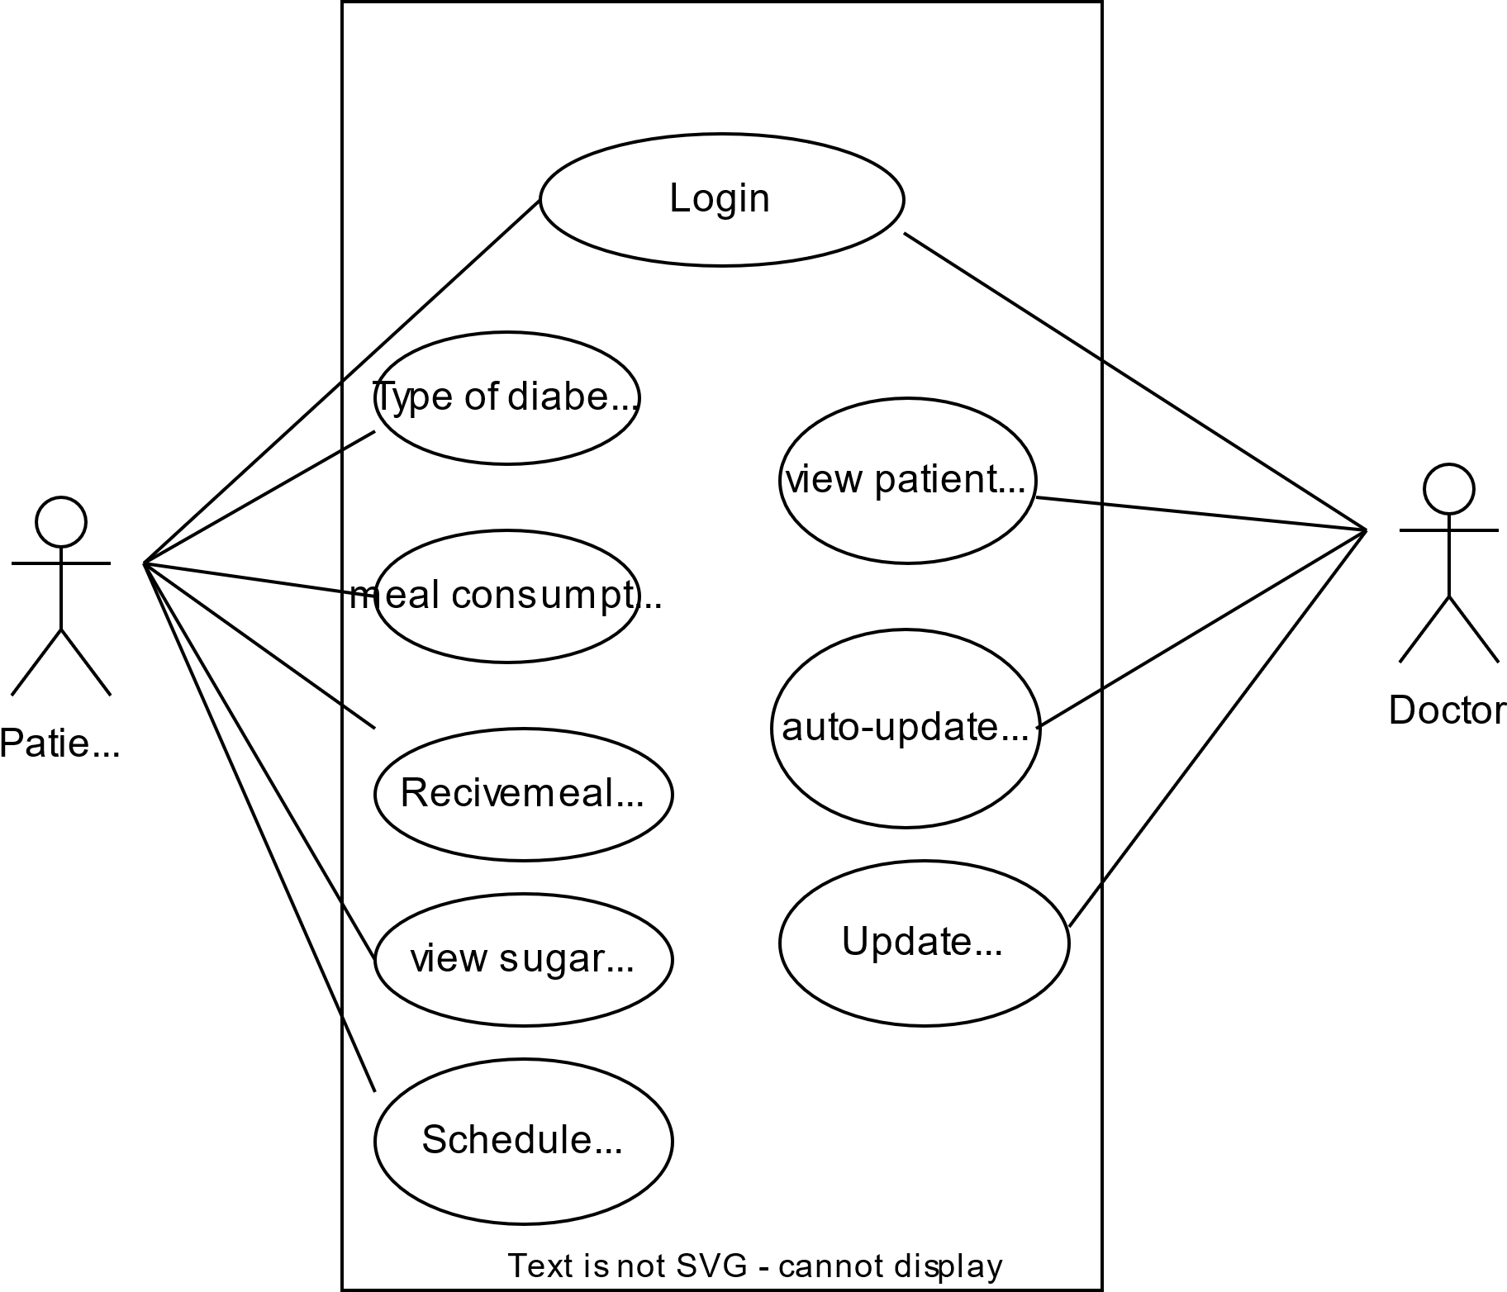
Use Case Diagram
Clinical Encounter
Diagnosis
&
Treatment Plan
Provide Medical History
Provide
Medical History
Review
Medical History
Report Symptoms
Perform
Physical Exam
Doctor
Patient
Present Medications
Order
Diagnostic Tests
Ask Questions
Express Concerns

Slide 18
Use Case Diagram
This use case diagram depicts the information exchange during a typical doctor-patient visit.
The patient actively participates by sharing details like their medical history, current symptoms, and medications. They can also ask questions and express any concerns.
The doctor reviews this information, performs a physical exam (and may order additional tests), and collaboratively with the patient arrives at a diagnosis and a personalized treatment plan.
This visualization underscores the importance of open communication and shared decision-making in achieving optimal healthcare outcomes.

Slide 19
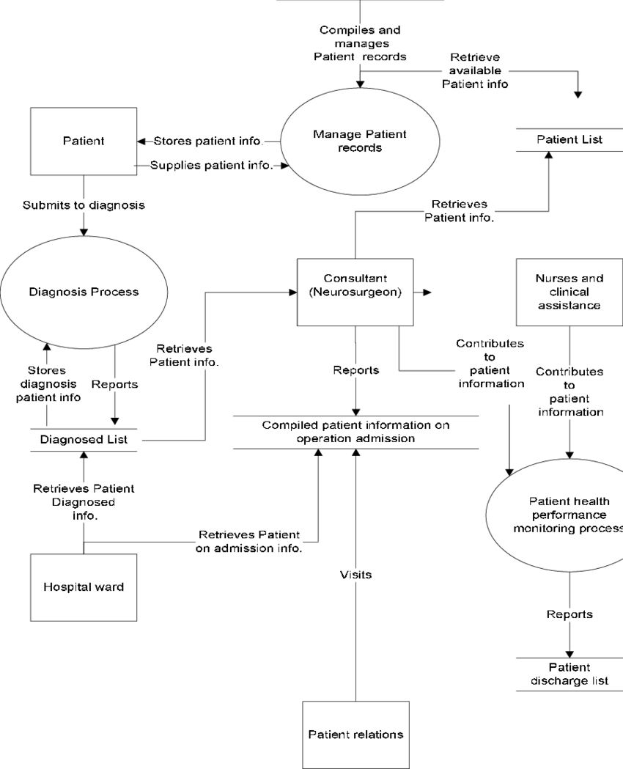
Data Flow Diagram
Patient
Dataset
Stores Patient Info
Collecting Patient’s records
Patient Lists
Submits Diagnosis
Retrieves Patient’s Info
Diagnosis Process
Clinical Text
Analysis
System
Clinical
Assistance
Retrieves Patient’s Info
Patient Medical History
Contributes Patient’s
Info
Stores
Patient’s Info
Reports
Patient Information
Medical Reports
Reports
Retrieves Patient’s Info
Patient Health Monitoring System
Retrieves Patient’s
History
Doctor
Visits
Reports
Patient
Discharge List
Patient
Relations

Slide 20
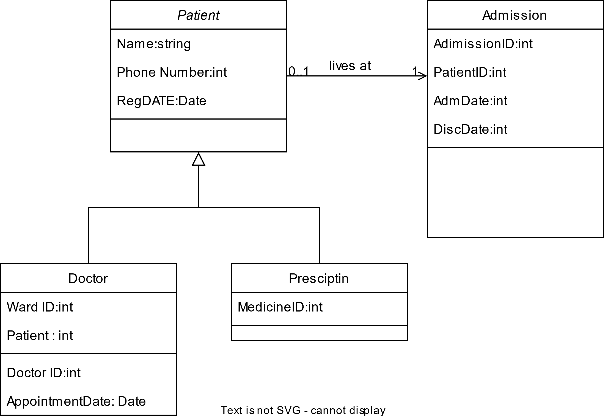
Class Diagram
Clinical_Text_Analyzer
Text_Processor
ClinicalTextAnalyzer
ehr_records
Methods
analyze_entities()
analyze_sentiment()
extract_keywords()
user_system
Methods
analyze_text(text)
Attributes
spacy_model
text_to_process
AnalysisResults
EHRRecords
Attributes
entities
keywords
Attributes
patient_records
get_record(patient_id)
Methods
display_results()

Slide 21
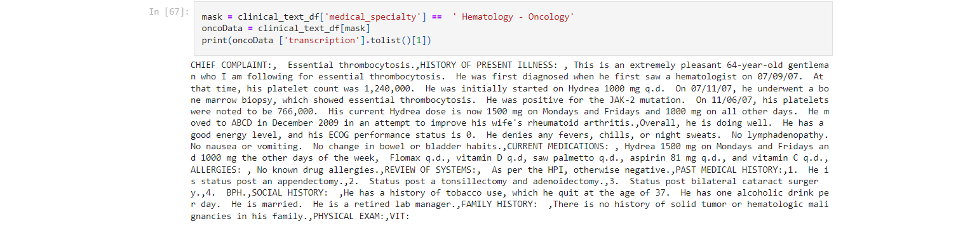
Experimental Results
A CSV FILE OF THE PATIENT’S MEDICAL HISTORY
A 23-year-old white female presents with complaint of allergies.
Allergy / Immunology : Allergic Rhinitis allergies when she lived in Seattle but she thinks they are worse here.
Medical History: In the past, she has tried Claritin, and Zyrtec. Both worked for short time but then seemed to lose effectiveness. She has used Allegra also. She used that last summer and she began using it again two weeks ago. It does not appear to be working very well. She has used over-the-counter
SUBJECTIVE:, This 23-year-old white female presents with complaint of allergies. She used to have sprays but no prescription nasal sprays. She does have asthma but doesn’t not require daily medication for this and does not think it is flaring up.
MEDICATIONS: Her only medication currently is Ortho Tri-Cyclen and the Allegra.,ALLERGIES: , She has no known medicine allergies.,
OBJECTIVE:,Vitals: Weight was 130 pounds and blood pressure 124/78.,
HEENT: Her throat was mildly erythematous without exudate. Nasal mucosa was erythematous and swollen. Only clear drainage was seen.
TMs were clear.,
Neck: Supple without adenopathy.
Lungs: Clear.,
ASSESSMENT:,Allergic rhinitis.,
PLAN:,
1. She will try Zyrtec instead of Allegra again. Another option will be to use loratadine. She does not think she has prescription coverage so that might be cheaper.
2. Samples of Nasonex two sprays in each nostril given for three weeks. A prescription was written as well.
Input:
Output:

Slide 22
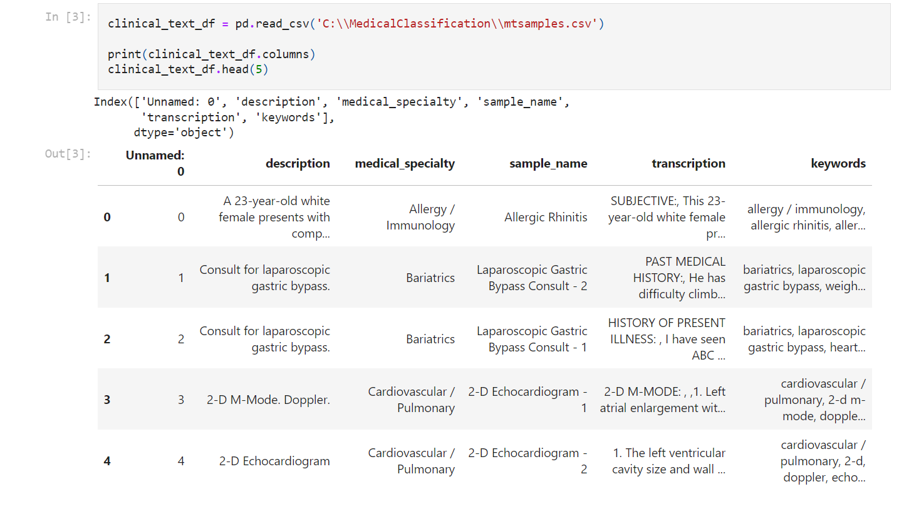
Screenshots of Results

Slide 23
Screenshots of Results

Slide 24
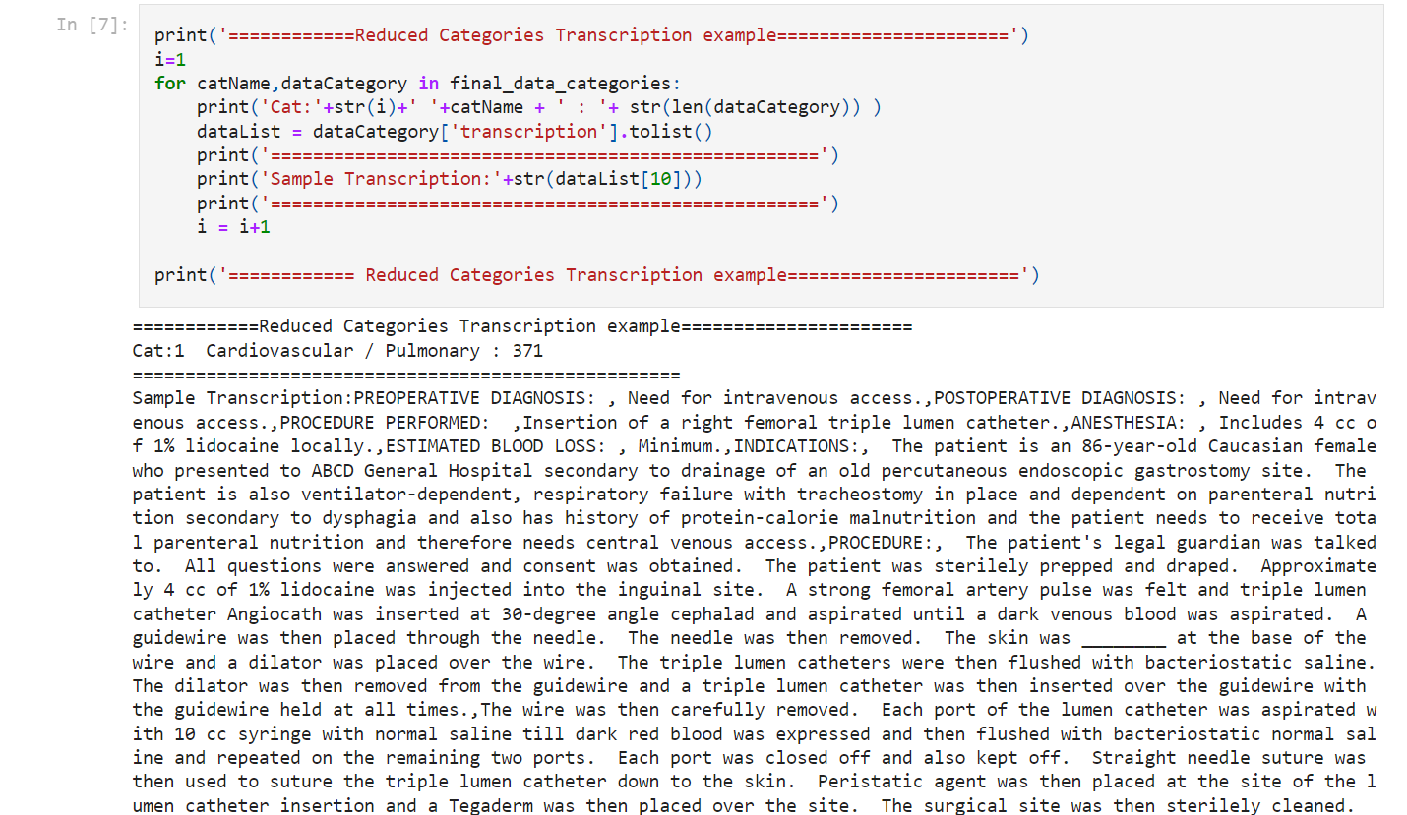
Screenshots of Results

Slide 25
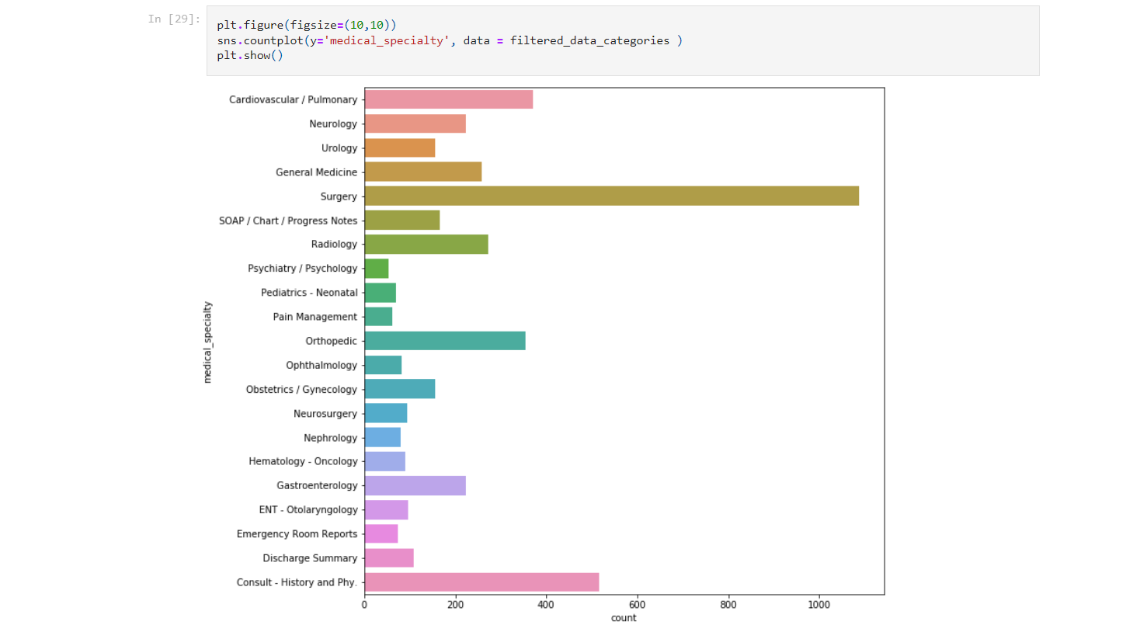
Screenshots of Results

Slide 26
Significance of the Proposed Method
Efficiency and Scalability:
By automating the analysis of large volumes of clinical text data, the method improves efficiency by reducing manual effort and time-intensive processes.
This scalability allows for the handling of diverse medical texts across different specialties and datasets
Enhanced Insights and Decision Support:
The advanced NLP capabilities of spaCy enable deeper insights into clinical data, supporting evidence-based medicine and facilitating clinical decision support systems.
Customization for Domain-Specific Needs:
SpaCy's customization features allow for the adaptation of NLP models to domain-specific terminology and language patterns commonly found in clinical texts.
This customization enhances the relevance and applicability of the method in extracting and understanding medical information accurately.

Slide 27
Conclusion
Improved Patient Care: By analyzing unstructured clinical text data (discharge summaries, progress notes, etc.), spaCy can help extract valuable insights that might be missed by traditional methods. This can lead to earlier diagnoses, more personalized treatment plans, and ultimately, improved patient outcomes.
Enhanced Clinical Research: spaCy can facilitate faster and more efficient analysis of large datasets of clinical text for research purposes. This can lead to new medical discoveries, improved treatment strategies, and better understanding of disease progression.
Reduced Manual Workload: NLP with spaCy can automate repetitive tasks of extracting information from clinical text reports, freeing up clinicians' time to focus on patient interaction and other crucial tasks.
Increased Speed and Accuracy: SpaCy's efficient processing capabilities can accelerate the extraction of clinical data compared to manual review. This can lead to faster diagnoses, quicker treatment decisions, and reduced error rates.
Entity Recognition: SpaCy excels at identifying key entities within clinical text, such as drugs, diseases, procedures, and anatomical locations. This information is crucial for building knowledge graphs, tracking trends, and supporting clinical decision making.
Relationship Extraction : Certain spaCy models can identify relationships between entities, revealing valuable insights like drug interactions or disease co-occurrences. This information can be used to improve patient safety and develop more targeted treatment strategies.
Leveraging Existing Infrastructure: spaCy is a well-established open-source library, reducing the need for expensive proprietary software or custom NLP solutions. This makes the technology more accessible to healthcare institutions with resource constraints.
Hence , the proposed work with NLP spaCy for clinical text analysis offers a range of benefits for both patients and healthcare institutions. By unlocking some of the crucial hidden insights, improving efficiency, and offering advanced capabilities, it has the potential to significantly transform healthcare delivery and research.

Slide 28
Future Enhancements
Clinical Question Answering: Developing spaCy-based systems that can answer specific clinical questions posed by healthcare professionals directly from the analyzed text data.
Sentiment Analysis: Explore using spaCy to analyze the sentiment expressed in clinical text, such as patient satisfaction with care or a provider's emotional tone in their notes. This information can be valuable for improving patient experience and communication.
Data Privacy and Security: Ensure robust data privacy and security measures are in place when using spaCy for clinical text analysis. This includes de-identification of patient data and adhering to relevant regulations like HIPAA.

Slide 29
References
[1] Xiao, W., Jing, L., Xu, Y., Zheng, S., Gan, Y., & Wen, C. (2021). "Extracting medication information from clinical text." Different Data Mining Approaches Based Medical Text Data. School of Medical Information Engineering, Chengdu University of Traditional Chinese Medicine, Chengdu 611137, China. Published in International Journal of Telemedicine and Applications.
[2] Guergana K Savova, James J Masanz, Philip V Ogren, Jiaping Zheng, Sunghwan Sohn, Karin C Kipper-Schuler, Christopher G Chute “Mayo clinical Text Analysis and Knowledge Extraction System (cTAKES)” Journal of the American Medical Informatics Association
[3] Bethany Percha, Department of Medicine and Department of Genetics and Genomic Sciences, Icahn School of
Medicine at Mount Sinai, New York, NY 10025, USA.“Modern Clinical Text Mining: A Guide and Review”
[4] Krishna Prasad Chodey; Gongzhu Hu, Title: “Clinical text analysis using machine learning methods” Published in: 2016 IEEE/ACIS 15th International Conference on Computer and Information Science (ICIS)

Slide 30
[5] Wenke Xiao,Lijia Jing,Yaxin Xu,Shichao Zheng,Yanxiong Gan,1and Chuanbiao Wen, School of Medical Information Engineering, Chengdu University of Traditional Chinese Medicine, Chengdu 611137, China Title: “Different Data Mining Approaches Based on Medical Text Data”
[6] Irena Spasić , Jacqueline Livsey , John A. Keane , Goran Nenadić ,School of Computer Science & Informatics, Cardiff University, Cardiff CF24 3AA, UK “Text Mining cancer – related information: Review of Current Status and Future Directions”
[7] Yadan Fan & Rui Zhang , Institute for Health Informatics, University of Minnesota, Minneapolis, MN, USA, “Using natural language processing methods to classify use status of dietary supplements in clinical notes”
[8] S. Velupillai , D. Mowery , B. R. South , M. Kvist , H. Dalianis “Recent Advances in Clinical Natural Language Processing in Support of Semantic Analysis”

Slide 31
[9] “Launching into clinical space with medspaCy: a new clinical text processing toolkit in Python”
https://www.ncbi.nlm.nih.gov/pmc/articles/PMC8861690/
[10] “Clinical Text Data in Machine Learning: Systematic Review”
https://www.ncbi.nlm.nih.gov/pmc/articles/PMC7157505/

Slide 32
Thank You

